Slide 1

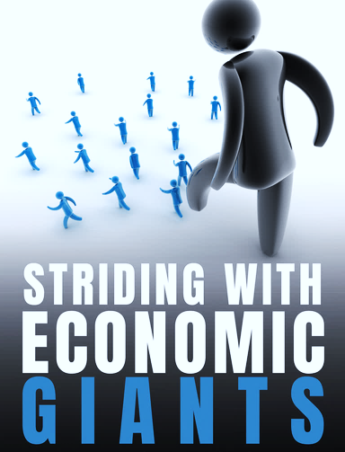

ECON251 Industry and Trade in Asia
Does size matters ?
A look at China and India economy

Slide 2
Lesson Objectives
At the end of the lesson , students should be able to
Explain the key features of the China Economy that led to her successful growth
Explain the type and level of state intervention in the growth path of China
Explain the type of trade liberalisation tools China adopts
Explain the problems that rose from China’s rapid growth
Explain the key features of the India economy
Explain the various trade liberalisation tools that India adopts
Explain what limits the growth of the Indian economy
Explain the role of the service industry that can reshape India’s growth path

Slide 3
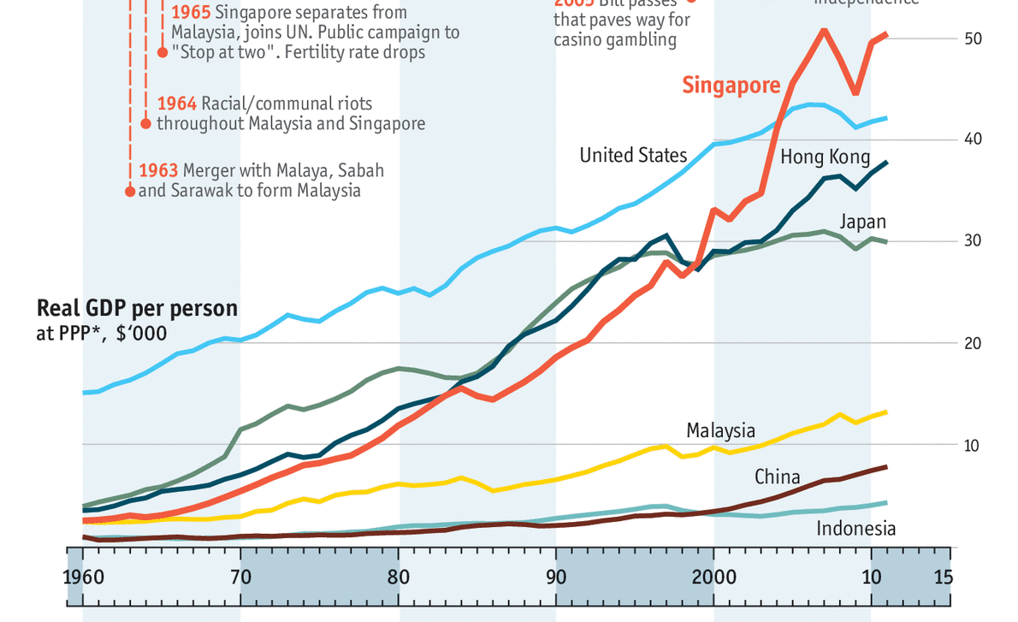
Introduction
They witnessed the benefits of outward growth by their nearby economies
But why they did not join in tgr with the rest ?
Rise of the giants : China, India
Lead goose
2nd & 3rd tier
The bubbles burst
Source: The Economist

Slide 4
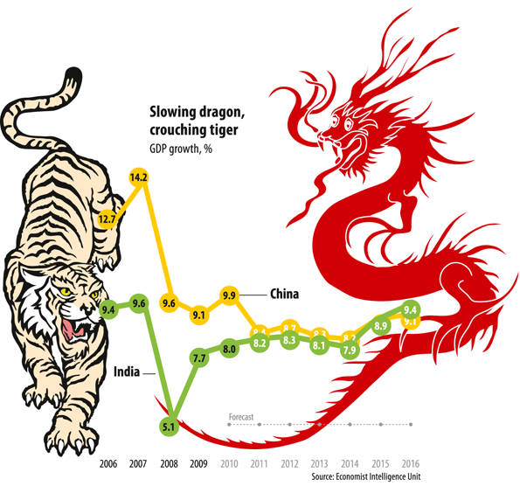
1. Introduction : DIVERGENCE
The Asia Giants with large population and land mass and thus a high GDP
But the two largest nations seems to be on a diverging path but converge at later stage as China’s growth rate slows down and India picks up
So what explains the path of divergence ?
Given their sheer size of GDP, an average of 9% growth is massive

Slide 5
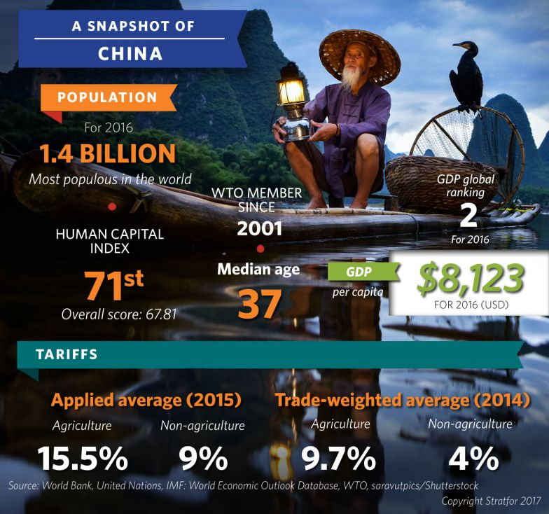
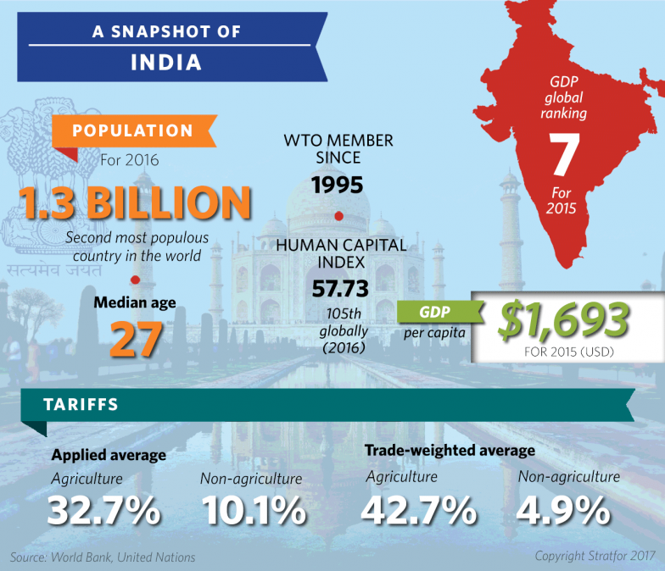
“Human capital index reflects the productivity as a future worker of a child born today, compared with what it could be if he or she had full health and complete, high-quality education",
The Similarities :
POPULATION size
Trade : joined WTO, low tariff
The Differences : And sufficient to explain their diverging paths ?
GDP per capita : Labour productivity
Human capital index
Tariff on agriculture
Notes:
Similarities : population size , top 10 economies, WTO membership
Difference Economic structures : tariff rate , GDP per capita, HCI index

Slide 6
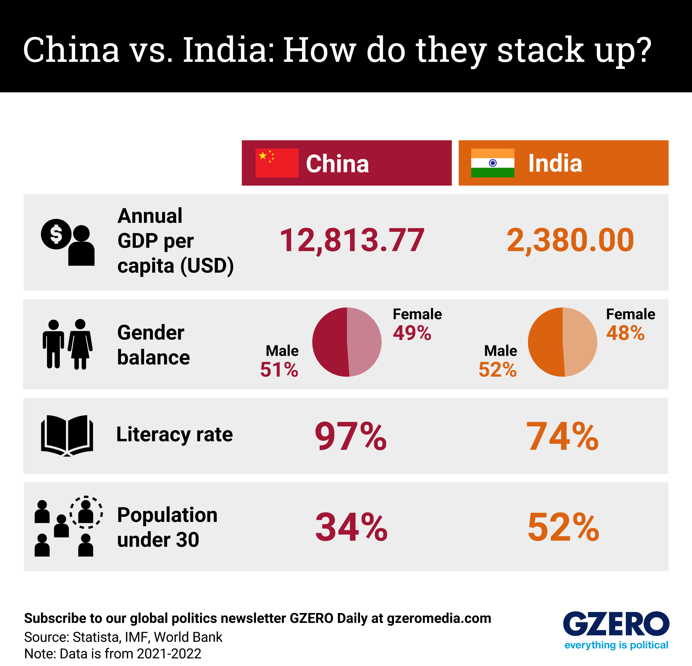
A closer examination
Critical factors

Slide 7
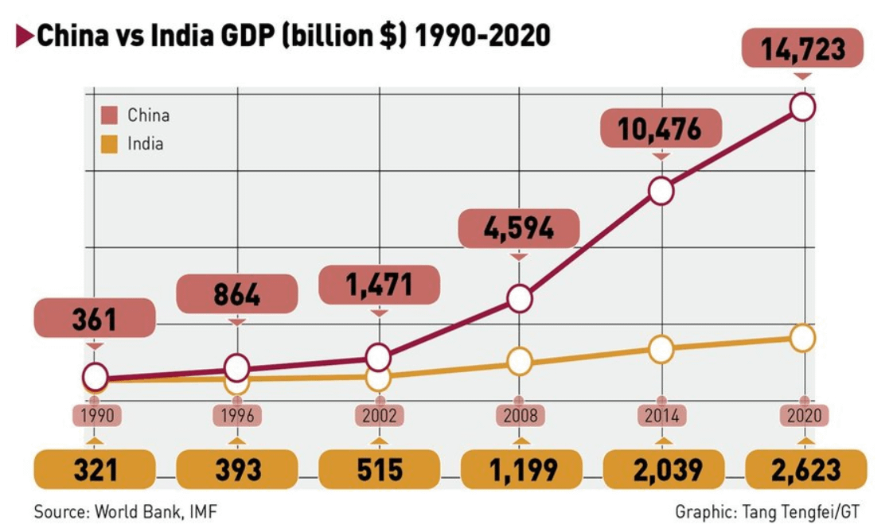
Giants awakens but on Path of divergence

Slide 8

A close examination of the two giants
We will examine in greater details of the factors driving China's growth accounting for the path of divergence
Then we also consider the possible path of convergence

Slide 9
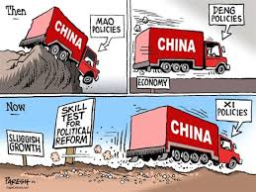
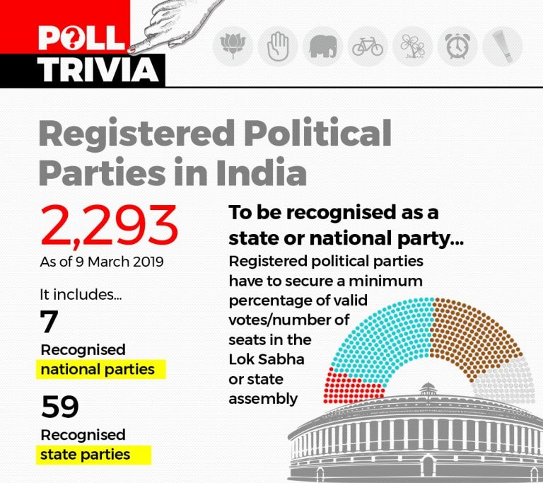
1. Factors of divergence Political system & language
Recall the imposition of pandemic emergencies act in these economies in year 2020
Impact on
State planning and implementation
Implications
China
Single political party
1 common language (Majority)
India
7 national political parities
>30 languages

Slide 10
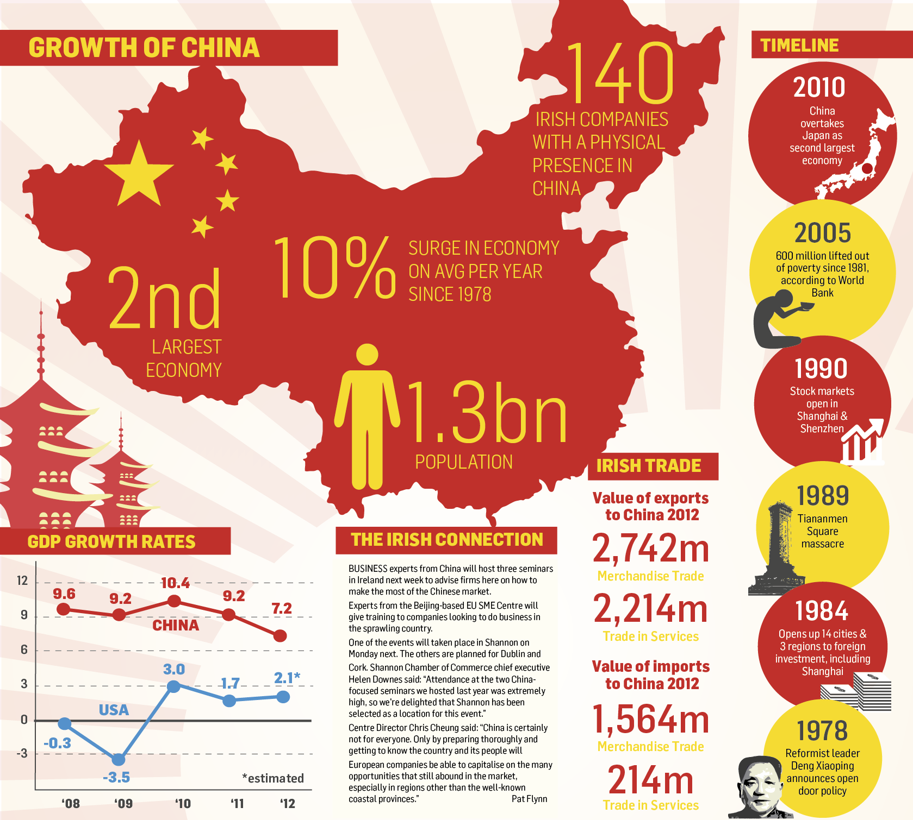
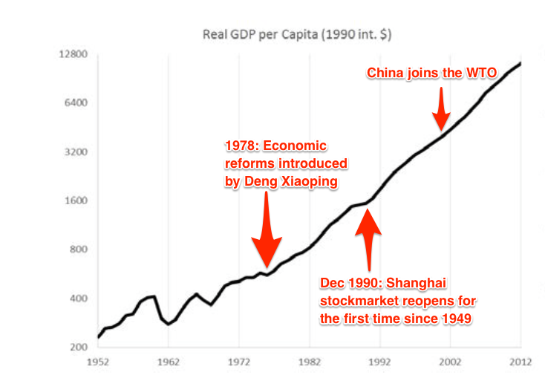
Video Link : https://www.scmp.com/video/china/2172457/how-forty-years-reform-and-opening-have-transformed-china
Trade reforms towards trade liberalisation
Multilateral trade integration
Financial reforms
Economic Reforms in China

Slide 11
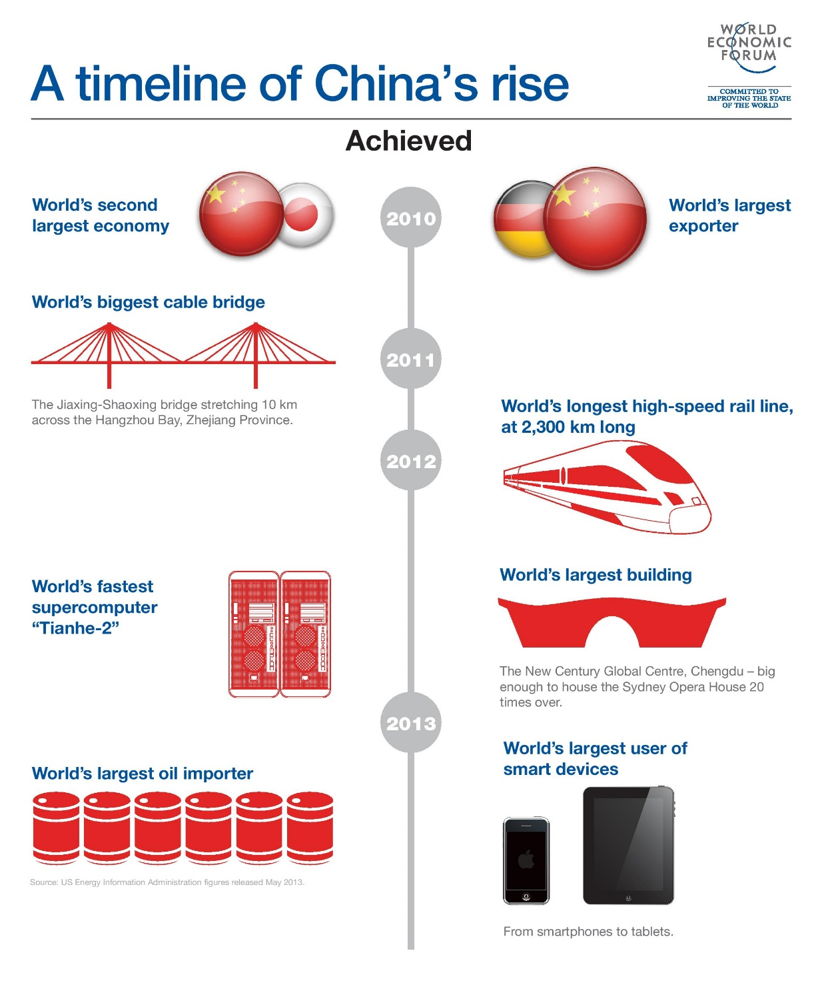
The great awakening of China
As she took all the key essential steps of industrialisation and outward growth, she did not experience the full-blown effect of the lead goose and fellow tier 1 geese of shifting comparative advantage :
SHE is large enough to pass the ball to the inner cities

Slide 12

Path of divergence STATE OWNERSHIP ENTERPRISE
State owned Enterprise (SOE, China) vs Public Sector Undertakings (PUS , India)

Slide 13
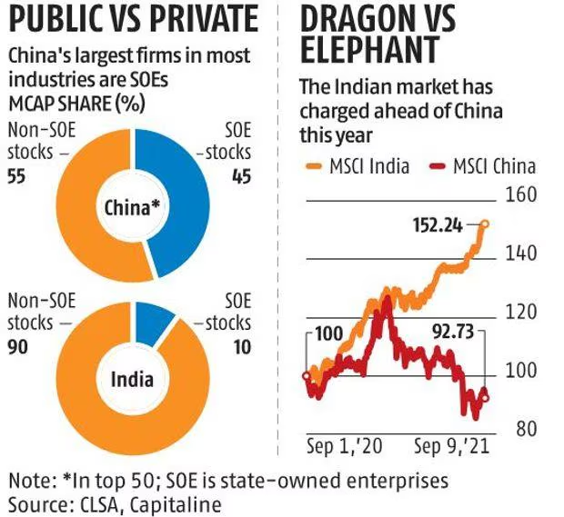
Direct roles of government in industrialisation and production
focus

Slide 14
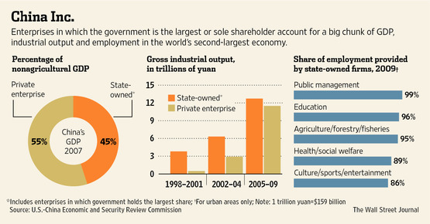
SOE & their contributions to economic progress

Slide 15
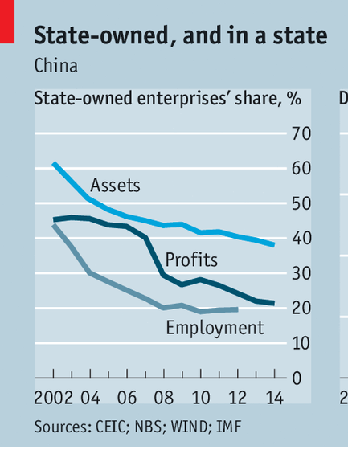
SOEs in China undertakes commercial activities on behalf of an owner government
They contributed 77 per cent of industrial output in 1978 but under the economic reforms, it is dwindling
Video Link: Until 2:22
https://news.cgtn.com/news/2021-06-14/Explainer-Why-China-has-so-many-state-owned-enterprises-115vt8ntcZ2/index.html

Slide 16
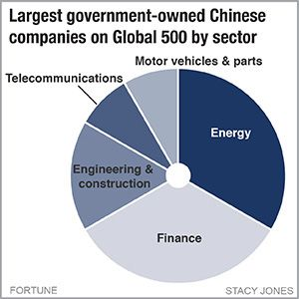
China’s SOE
Observe the type of industries : why do you think it anchors on these industries?
Requires massive infrastructure
National security

Slide 17
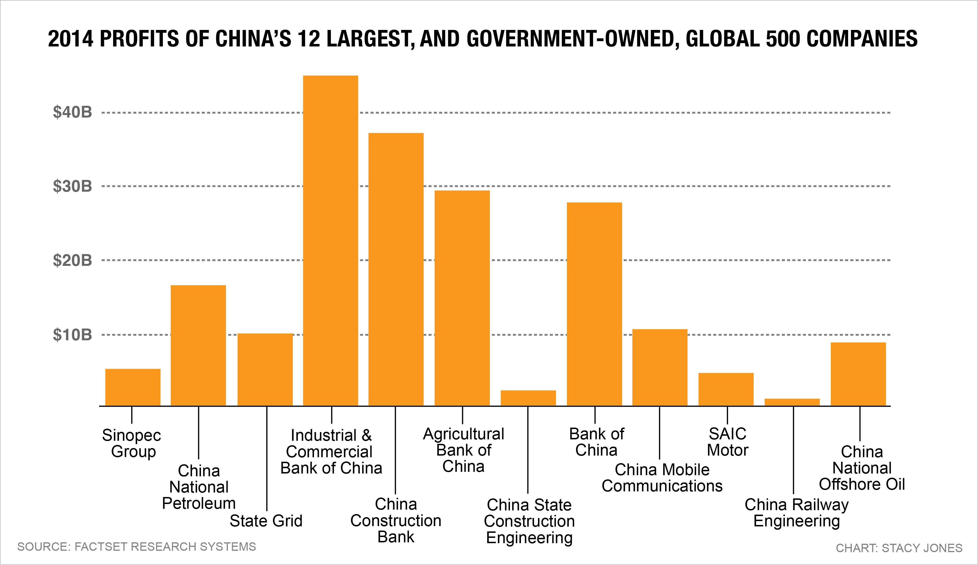
China’s SOE

Slide 18
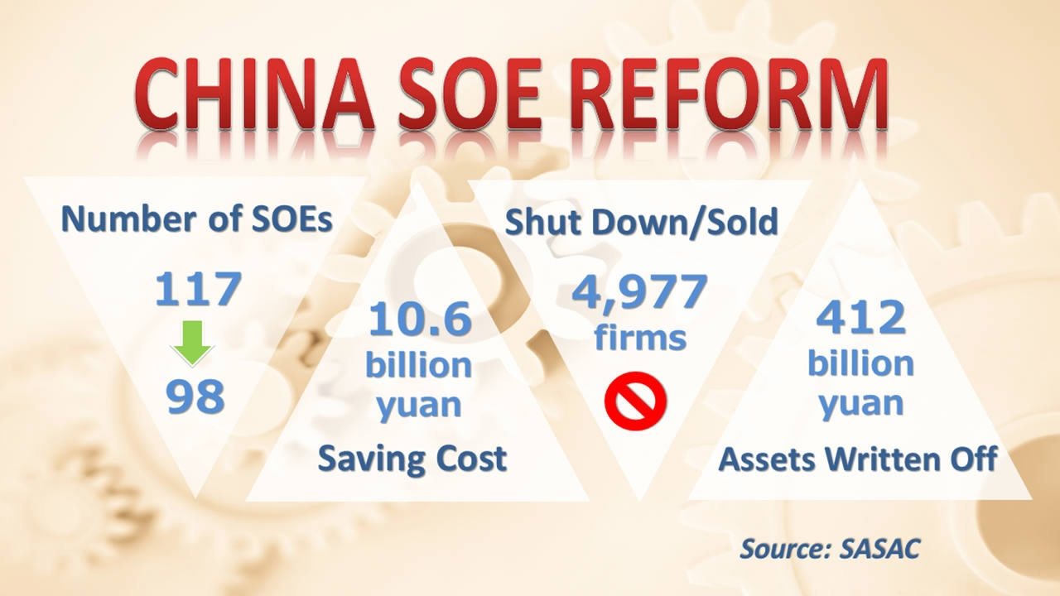
China: State Owned Enterprise (SOEs)
SOE gets easy access to cheap credit, and therefore they run at excess capacity (OECD, 2015)
Generally inefficient and breeding grounds of corruption.
Restructure state owned enterprises with greater autonomy on production scale
Mixed ownership [ to include private sector both local and foreign]

Slide 19
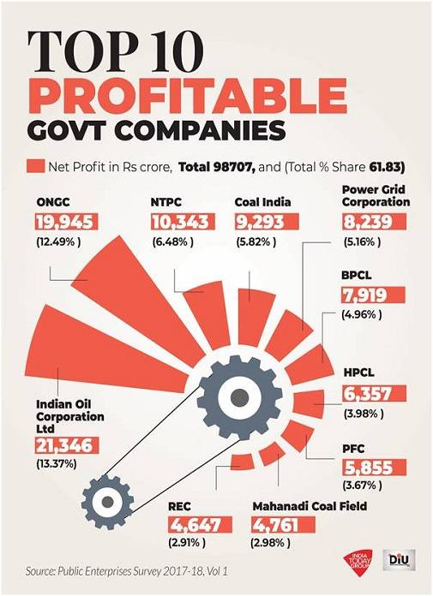
SOEs in India
India’s central government-owned enterprises—also known as central public sector undertakings (CPSUs)
mainly established from the mid-1950s to the mid-1980s,
SOEs enjoyed exclusive rights to operate in many key industries (Chhibber (2017)).
The economic liberalization policies implemented in the 1990s made it possible for private sector to operate in key sectors including mining, electricity, and transportation, which were previously reserved for SOEs.
Only 58 public listed SOES (as compared to China)

Slide 20

Path of Divergence Capital growth and Funding
This Photo by Unknown Author is licensed under CC BY-NC-ND

Slide 21
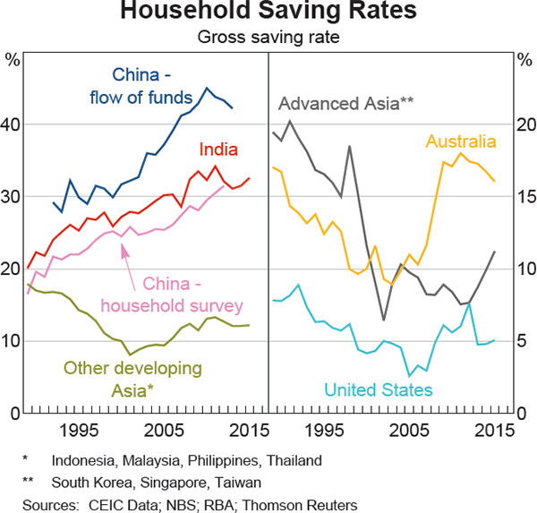
Key factors of growth - Capital Accumulation
Corporate savings
Household savings
FDIs
Supply of capital funds
Requires an established and vibrant financial market : E.g in HK, In Shanghai
Also apply the harod Domar model
g (growth rate) = s / v [ where s is the savings rate]

Slide 22
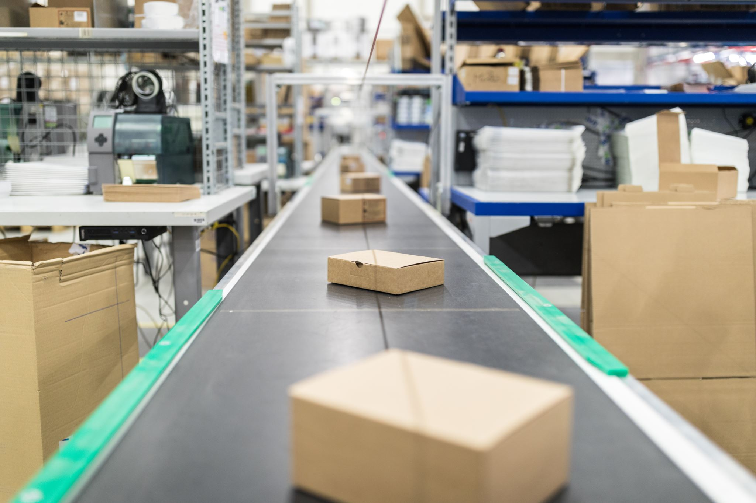
PATH OF DIVERGENCE Rate of Industrialization

Slide 23
Path of divergence RATE OF INDUSTRIALISATION Key observations a. size of manu vs agr btw the two economies b. devt of the agri sector
A significant larger size of manu sector in china
Identical size of manu and agr and a growing agr sector
Data from database: World Development Indicators

Slide 24
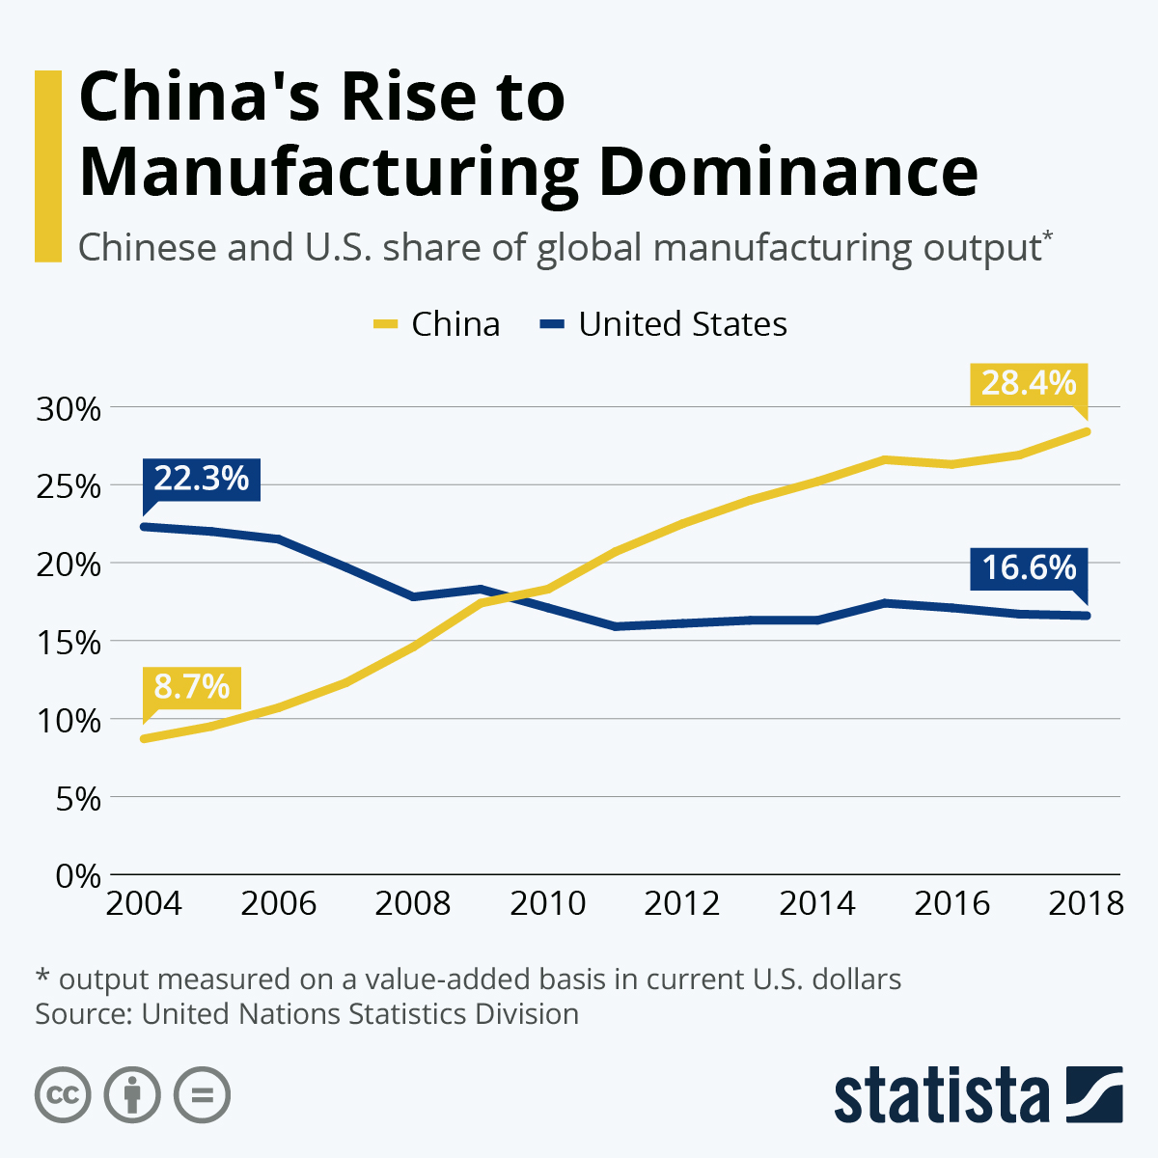

Slide 25
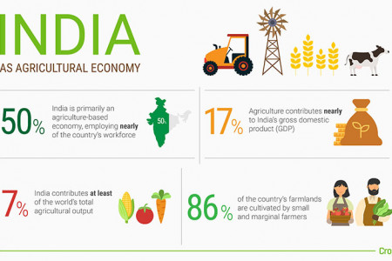

Slide 26
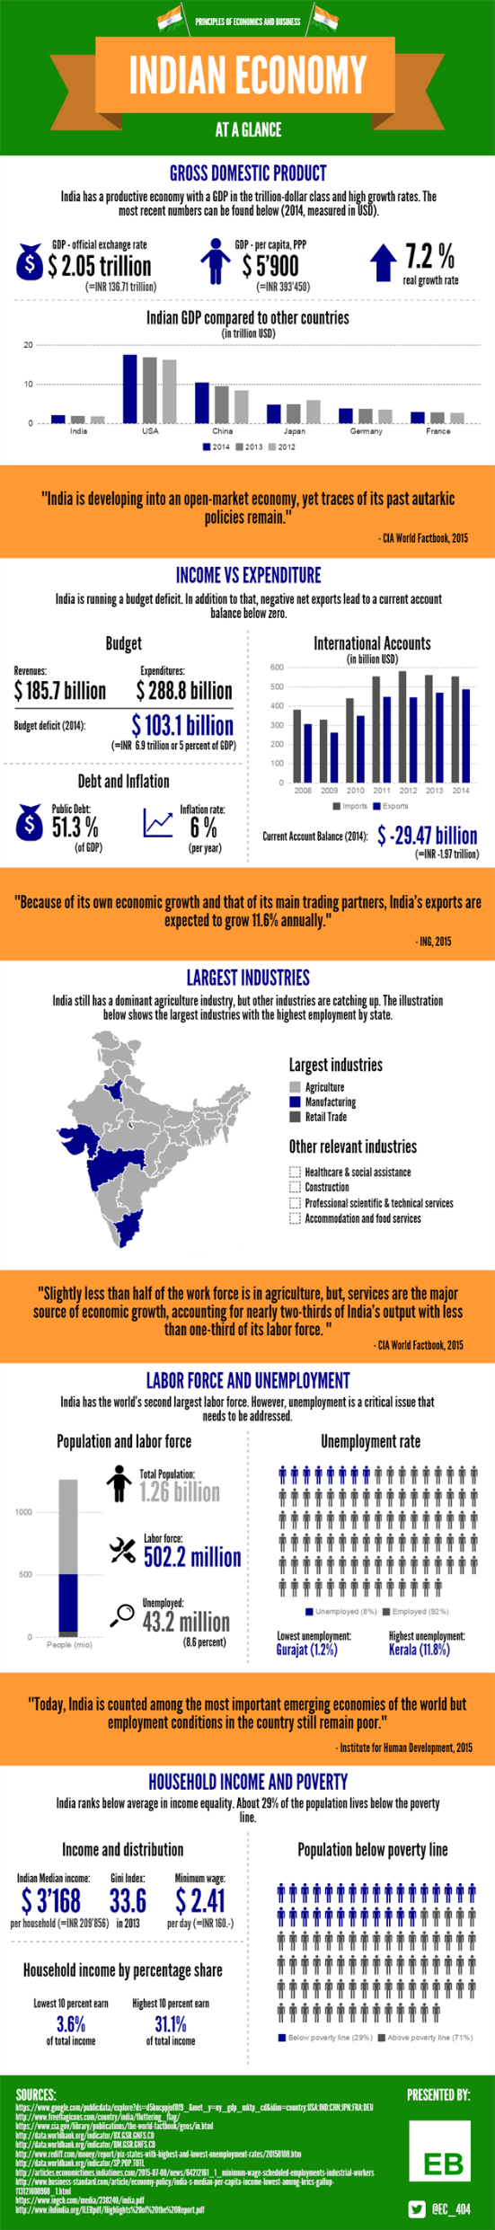

Slide 27
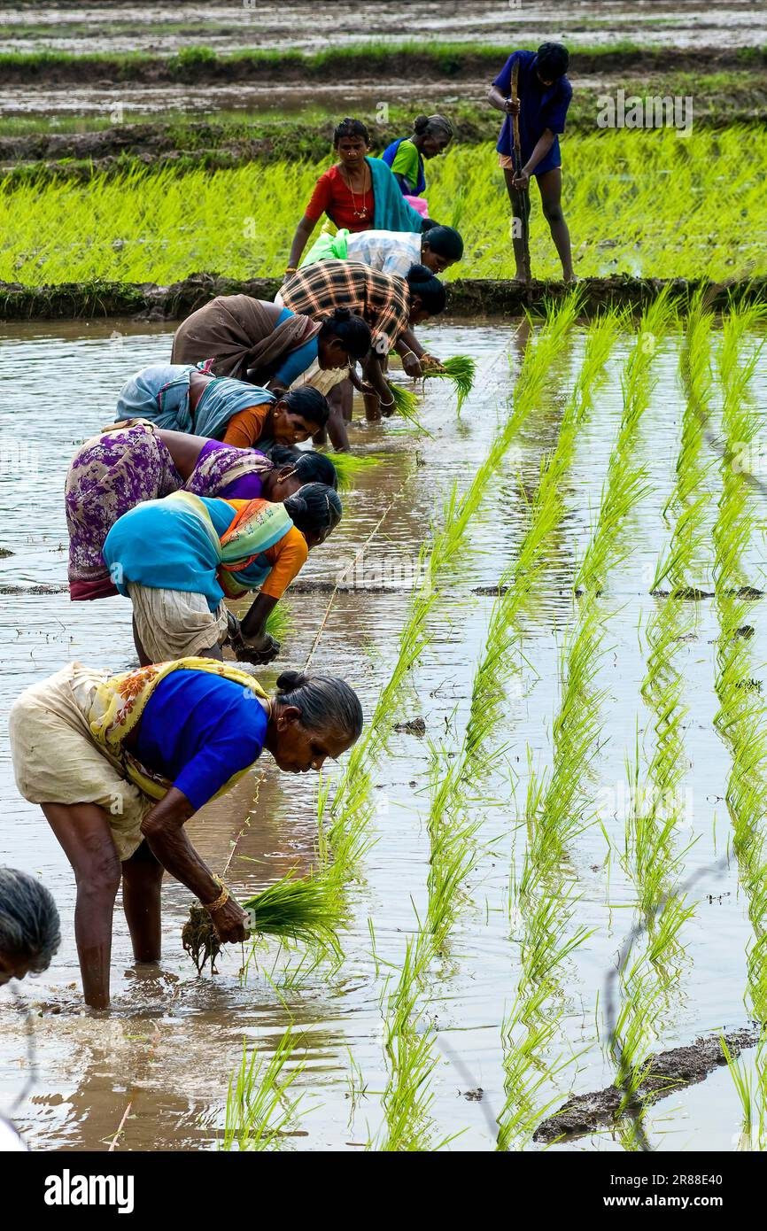
Path of divergence RATE OF INDUSTRIALISATION Agriculture sector Reform in India – A difficult decision?
Main objective : FOOD SECURITY
Development of this sector is to first meet food security purpose [recall the unstable supply but required to feed its growing population ]

Slide 28
Path of divergence RATE OF INDUSTRIALISATION Agriculture sector Reform in India – A difficult decision?
Large financing (in terms of subsidies, support of buffer stock) from government for this sector to expand its production to meet the domestic food demand.
The large financing in fact result in greater complacency and lower productivity

Slide 29

PATH OF DIVERGENCE TRADE LIBERALISATION

Slide 30
3
2
1
Key observations
Phase 1: Despite India joins WTO much earlier, her total trade is much smaller
Phase 2: Sharp rise in China's total trade after she is a WTO member from year 2000
Phase 3 : We will revisit this discussion under path of convergence

Slide 31
2. Lowering of tariffs

Slide 32
India : Why a slower path of trade liberalisation Limitation in promoting agriculture as key export sector
If this sector is target as a key exporting sector, part of outward oriented growth strategy
With ongoing of India government support system then the possible impacts are
- A threat to food security objective [Farmers will be more motivated to sell to international market]

Slide 33
India : Limitation in promoting agriculture as key export sector
Cannot readily meet the export demand due to
- Poor infrastructure affecting timely supply of inputs and timely transfer of outputs from Indian farms.
Excessive regulations
Movement of agricultural produce is heavily regulated, with inter-state and even inter-district restrictions on marketing and movement of agricultural goods
- Unstable and low source of export earnings

Slide 34
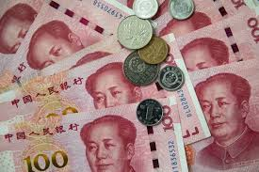
Trade Liberalization : China Financial market and the Exchange Rate
In the 1950s to 1980s
Dual-track currency system was instituted, with renminbi usable only domestically, and with foreign visitors to China forced to use foreign exchange certificates.

Slide 35
Financial market and the Exchange Rate
In the late 1980s and early 1990s, China worked to make the RMB more convertible and the dual track system was removed
The RMB was pegged to the US dollars
I.e. a Fixed exchange rate system
Video Link:
https://www.investopedia.com/terms/c/currency-peg.asp
Is it Yuan or Renminbi ??
https://www.investopedia.com/articles/forex/061115/yuan-vs-rmb-understanding-difference.asp

Slide 36
Phase 1
2
4. Trade liberalization
Flow of FDIs
Average net FDI inflow (% 0f GDP)
China: 2.82%
India : 0.9%
Key observations:
Phase 1: MNCS flowed into china, to produce for the Chinese market
Phase 2 : Geopolitical tensions : FDI flows out, or into India - Wait and see approach

Slide 37
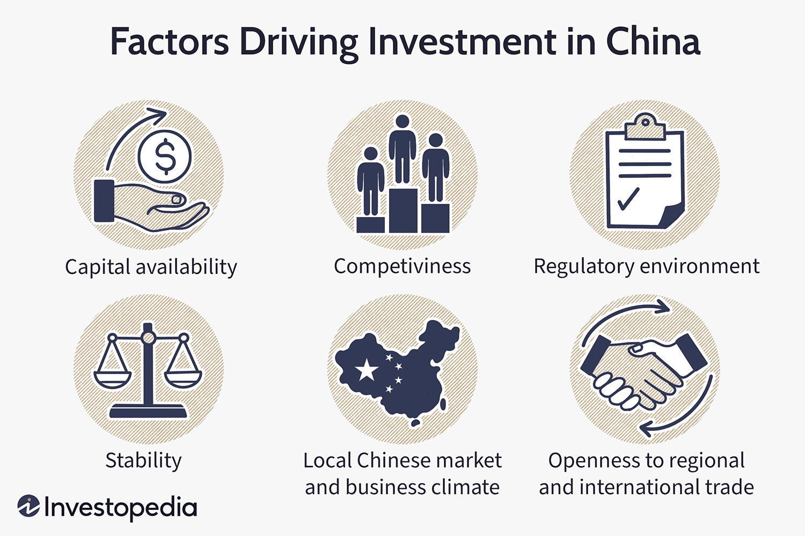
Cater to needs of this large sized market
e. g Automobile
FDI Inflows in China
https://www.investopedia.com/articles/economics/09/factors-drive-investment-in-china.asp

Slide 38
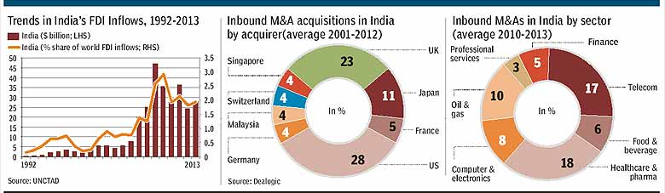
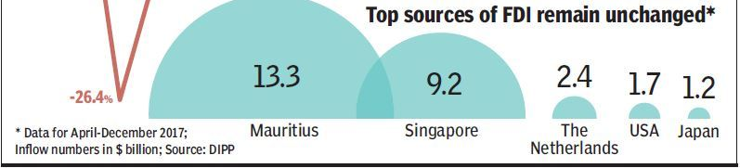
FDI flows
Minimal impact of Economic reforms to attract FDI

Slide 39

FDI reforms
India has not been successful in attracting FDI. This is mainly due to, the democratic nature of India where the
central government having control over attracting FDI without devolving power to local authorities. [ Red tape, bureaucracy at local state level]
This Photo by Unknown Author is licensed under CC BY

Slide 40
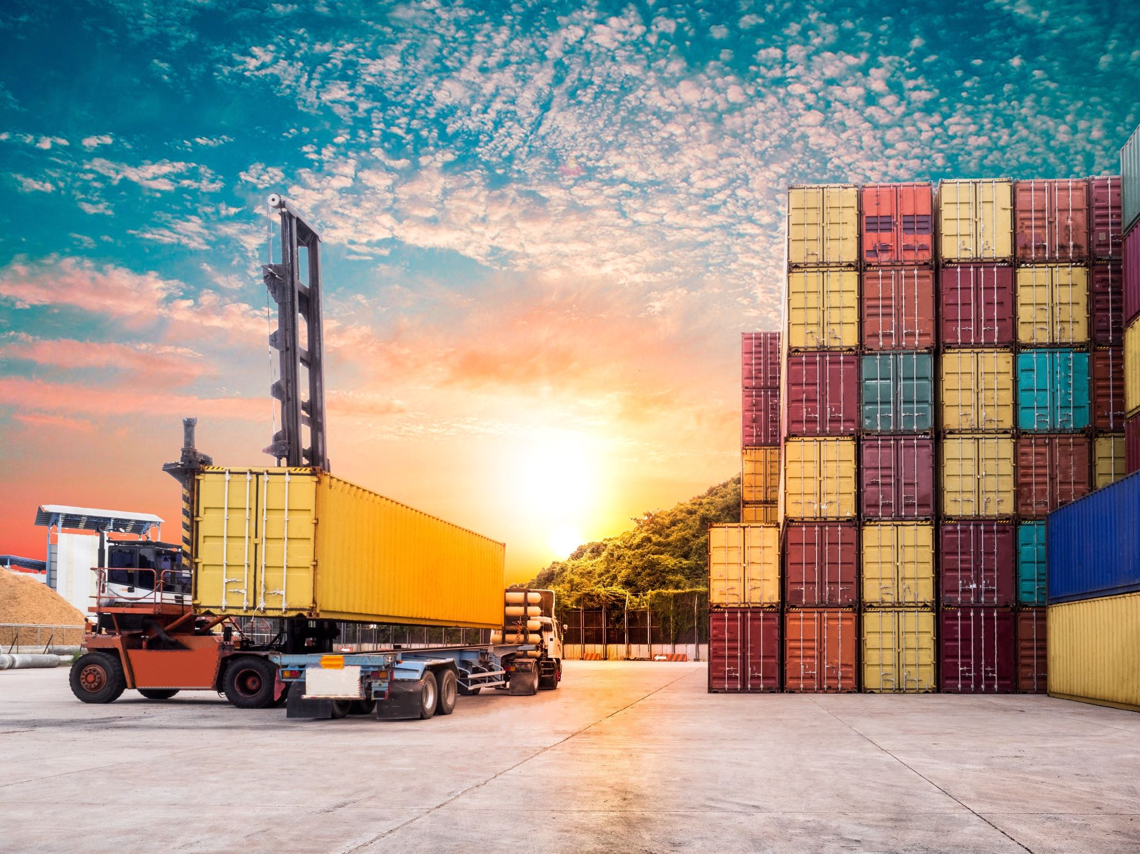
Trade liberalization Improving connectivity
Export processing Zone
Port development
Container shipping

Slide 41
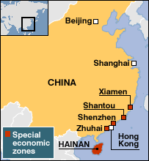
Trade liberalisation of China
SEZs have been established in the eastern region of China along the coastal line cities since 1979.
In 2014, there were 6 SEZs, 14 open coastal cities, 4 pilot free trade areas and five financial reform pilot areas.

Slide 42
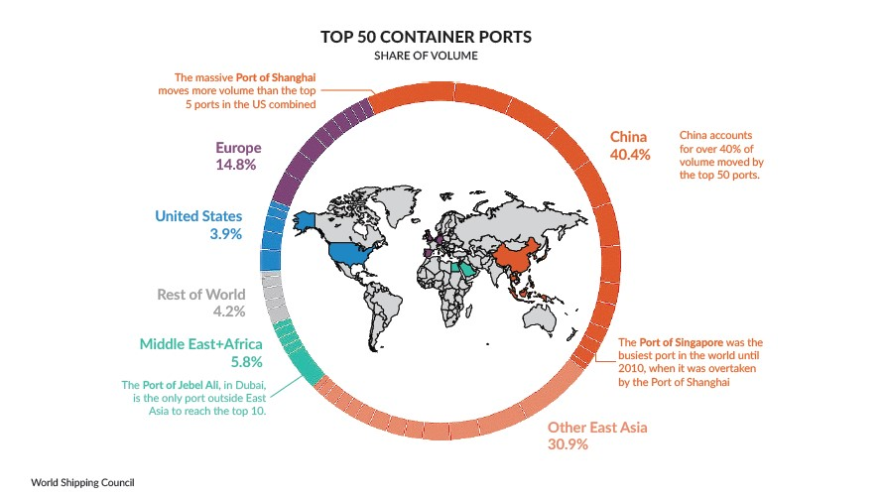
5.1 Improving Connectivity From silk road to BRI
Connectivity
The well known trip : Zheng He in early 15th century
Video Link: until 4:20 https://youtu.be/gTXc5Of5-j8?si=9xQDyQFERJAptg3P
And now : The belt – route initiative
Within China
From China to all the ends of the world
40%

Slide 43
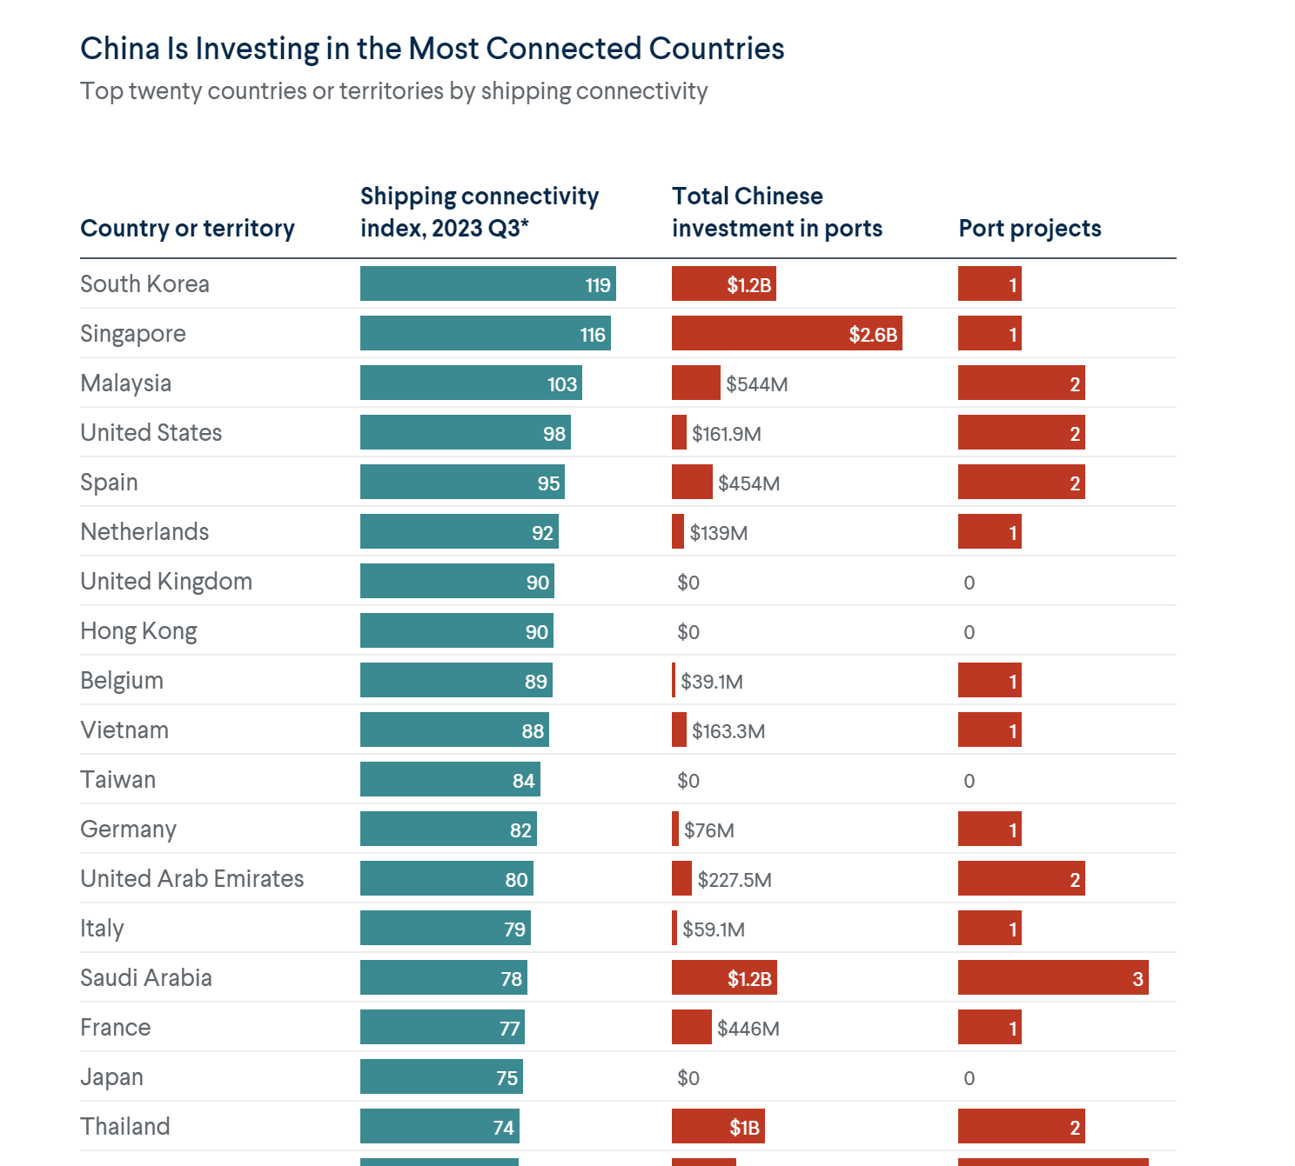

Slide 44

Path of convergence
Will India catch up with China ?
Video link: https://youtu.be/nOnqOP_4hhc?si=Cc6tlUl-K1rP4IFk

Slide 45

The tides have changed
China govt to focus on domestic market , domestic issues (widen income gap, rising youth unemployment) whilst India govt focus on international market
New waves of FDI : MNCS diversify their supply chain away or lesser on China : example Boeing, Apple
Emergence of digital economy

Slide 46

Emergence of the service sector
The possible path of convergence
(ie India to catch up with China)

Slide 47
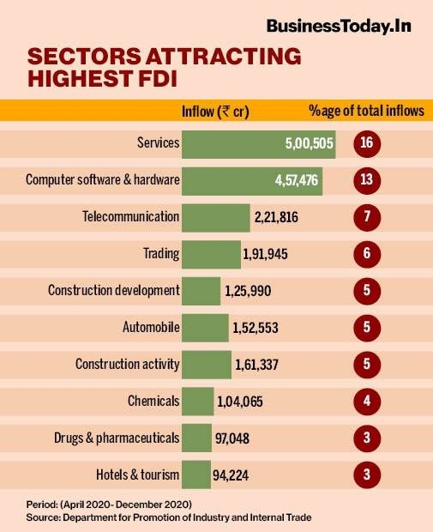
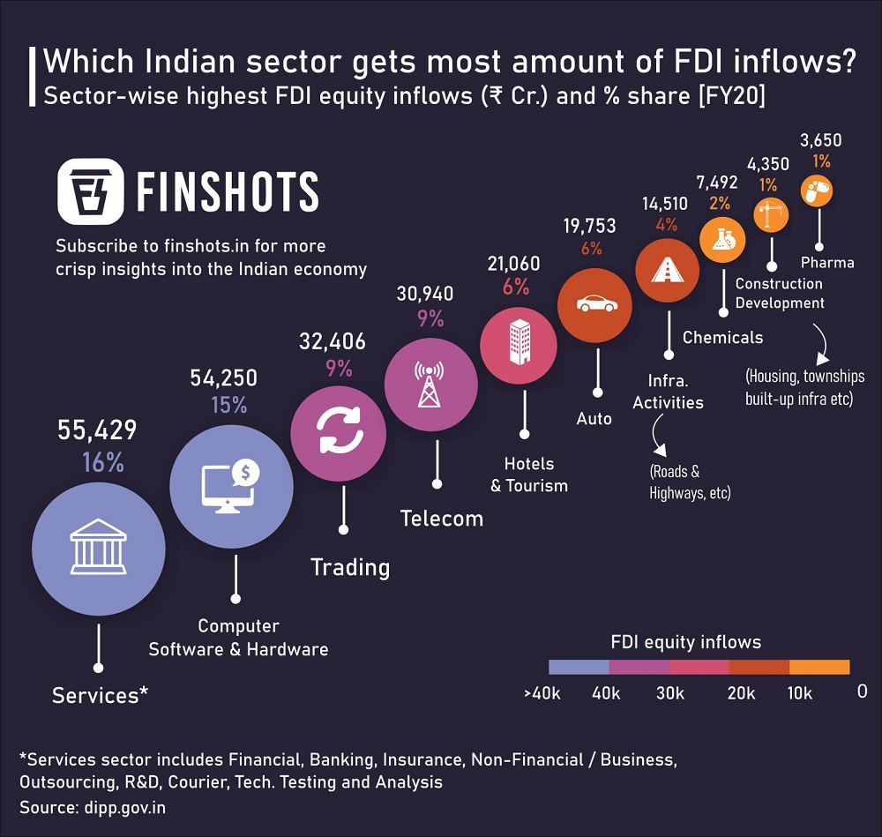
The Digital ERA and the ICT industry

Slide 48
The service sector comprise mainly of
Information technology-related (IT) services and research and development (R&D) services; The computer software sector grew at 30 per cent per annum
The strength of shifts in the technologies and greater trade possibilities in a more connected world will enhance the demand for services and therefore service-led growth may sustainable.

Slide 49
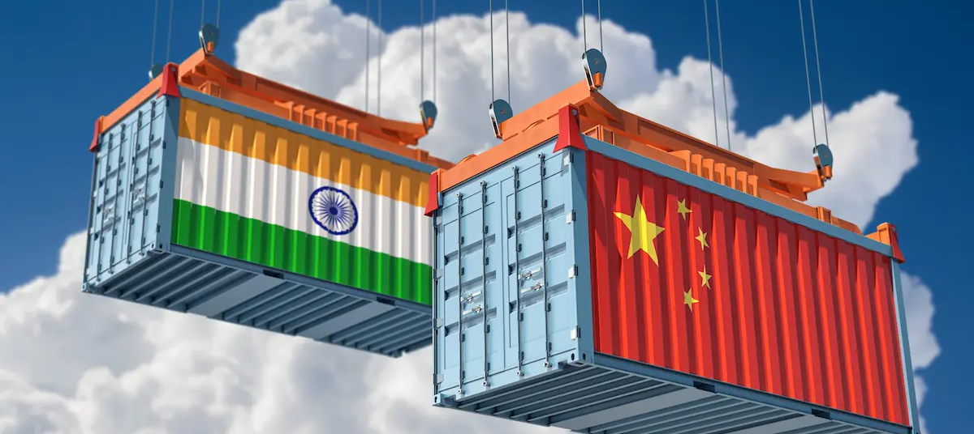
What lies ahead ? India: Growing population, younger work force + digital age = SUCCESS
https://www.cnbc.com/video/2024/05/06/investing-in-india-microsoft-discusses-one-fundamental-challenge.html

Slide 50
Email : ckon@uow.edu.au
Send me an email if you have any issues or concerns on
The lesson today
Access to Moodle
Any errors you spotted in the course materials
Sharing a news or video resource
I will respond to you within 48 hours.

